Slide 1
Predicting The Energy Output Of Wind
Turbine Based On Weather Condition
Using IBM Cloud
HRITIK MITRA(18BEI0156)
RISHITHA TAMMA(18BCD7116)
SOUMYA S. NAIR
TRIPTI MISHRA (18BCE0888)

Slide 2
Introduction:
We are going to deploy an application that will utilize multiple Watson AI Services including Cloud function, Watson Machine Learning,Weather Data.
During the course of this project,we’ll learn about combining Watson services, and how they can build customer satisfaction interactive portals for prediction on current conditions.

Slide 3
Problem Statement:
Wind power generation differs from conventional thermal generation due to stochastic nature of wind.
Wind power forecasting plays a key role in dealing with the challenges of balancing supply and demand in any electricity system.
Accurate wind power forecasting reduces the need for additional balancing energy and reserve power to integrate wind power.
In this system, the inlet condition of the wind farm is forecasted by the autoregressive model.

Slide 4
Hardware/Software Requirements
Cloud tool used: IBM
IDE: Jupyter notebook, syder, Anaconda navigator
Dependencies Required: Keras, Tensorflow, OpenCv
Programming language(Back-end): Python 3.6
Front-end: Html/css
Framework:Flask

Slide 5
Advantages:
Reduces man power
Easy to use and has a user friendly interface.
The weather conditions analysis that are not manually answered are responded to by the web dashboard.
Results can be improved by training data to our choice of parameter.
Weather analysis of different cities need not to be monitored.
Can be used in areas with less connectivity as well.
Cost efficient
Accurate results.

Slide 6
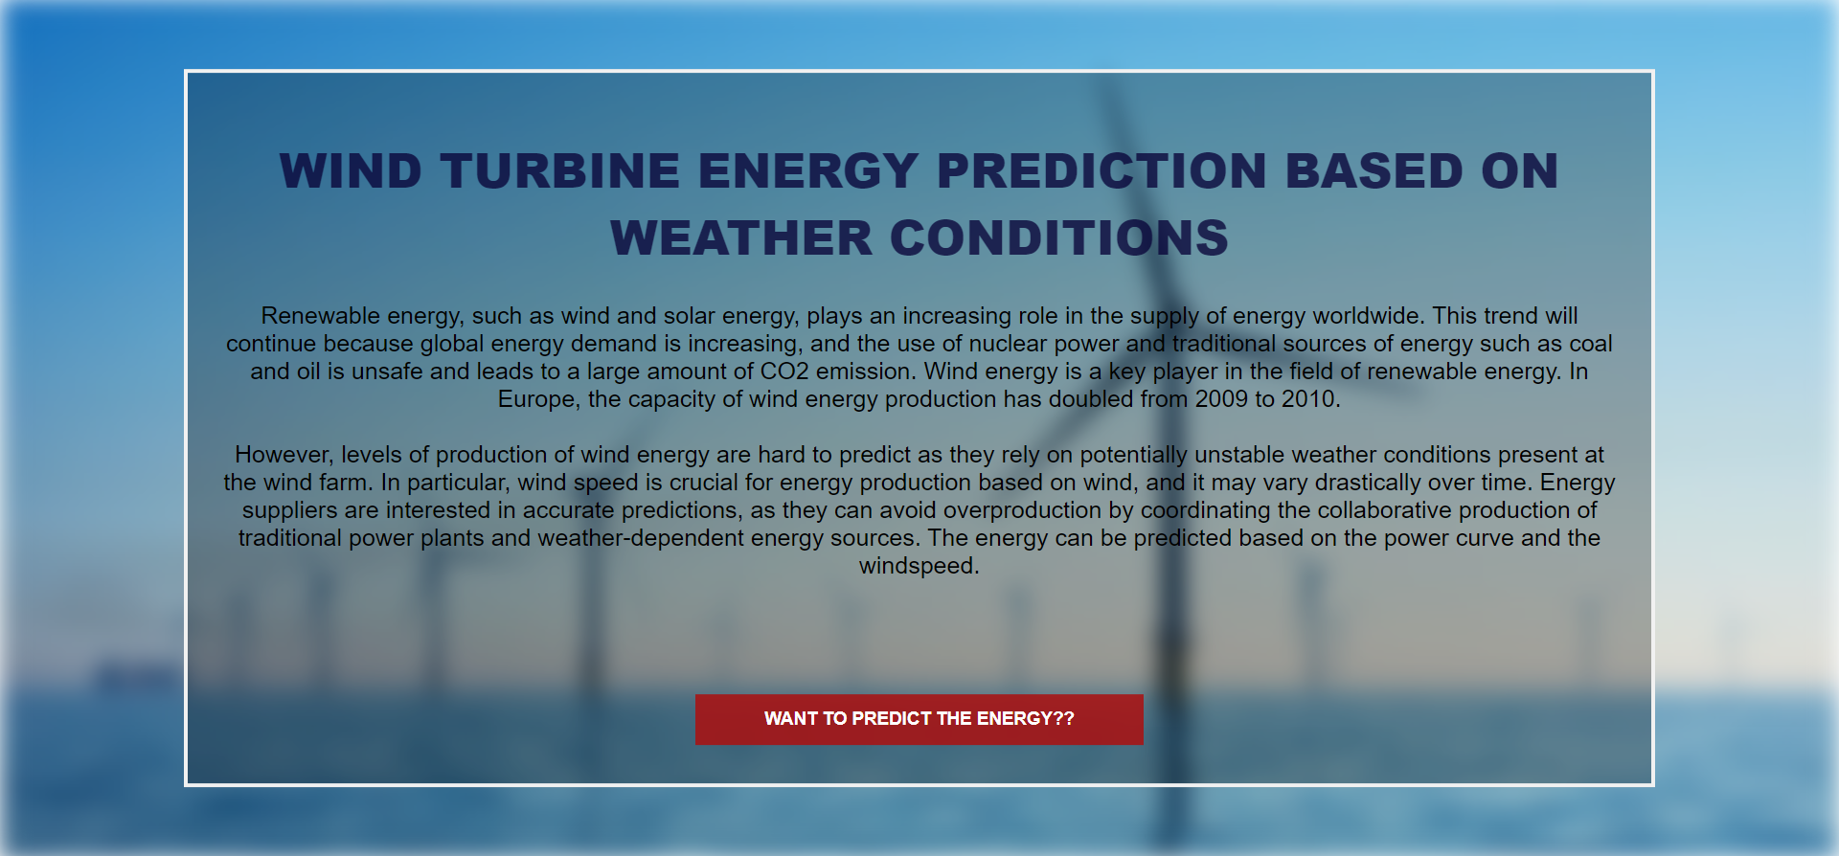
UI screenshot:

Slide 7
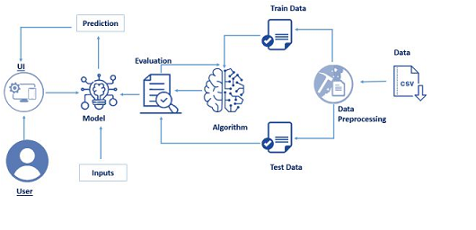
Block Diagram

Slide 8
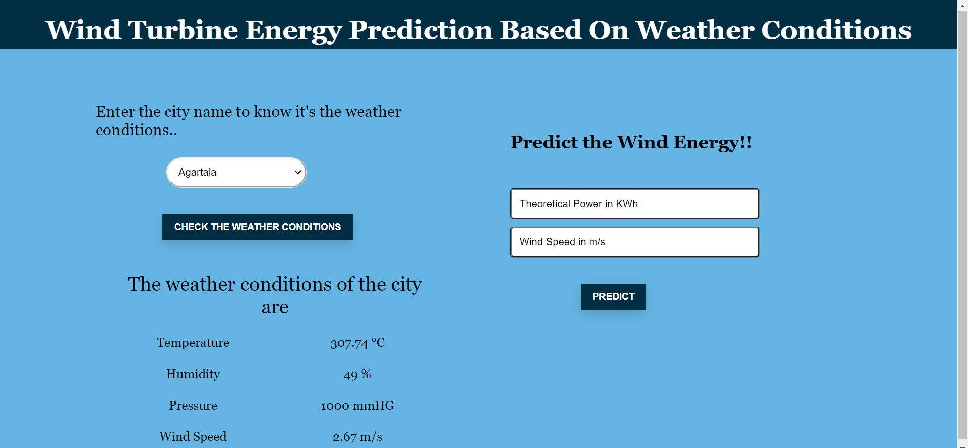
UI screenshot:

Slide 9
THANK YOU

